Slide 1

Leaders' School & College Chattogram
Class: IX (English Version)
L#01
Topic Name: Introduction to Python Programming
Md. Amin Kaiser
B.Sc. in CSE, DUET
Assistant Teacher(ICT)
E-mail: aminkaiser90@gmail.com

Slide 2
Contents
What is Programming?
What is Programming Language?
Why We Choose Python?
Creating Environment
Your First Python Program
How to Run Your Program
How Python Code is Executed
A Simple Test!

Slide 3
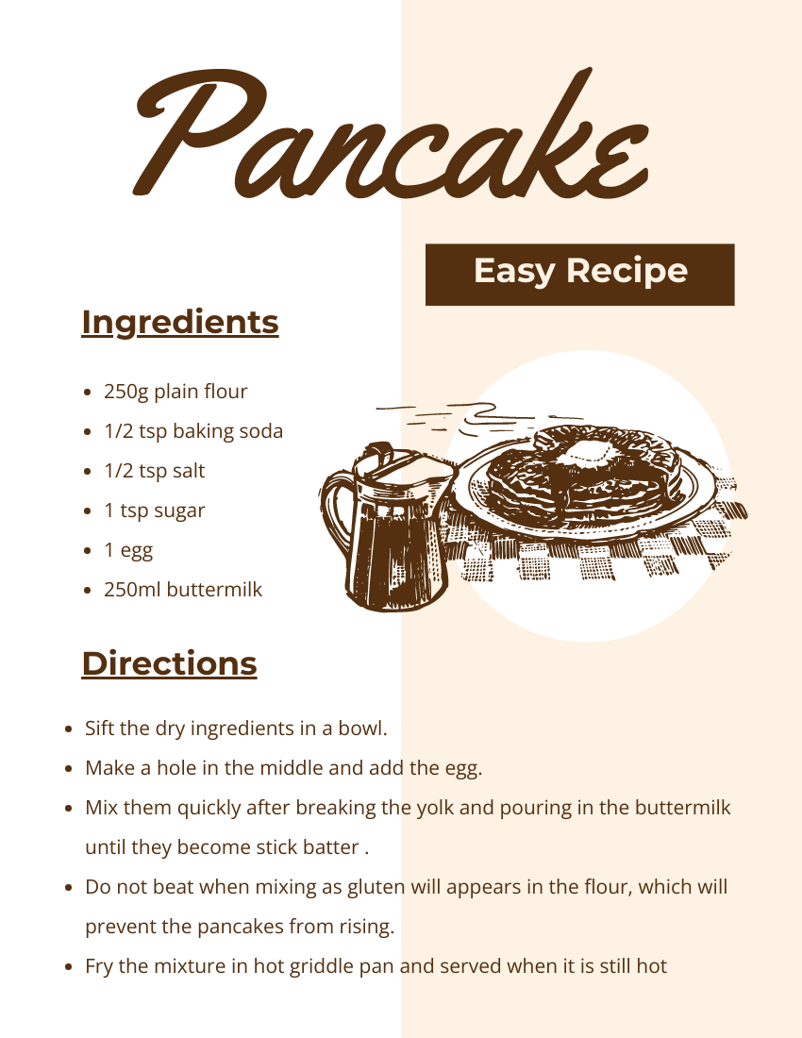
Have you Ever Made a Recipe?
We need to Follow some instructions!
Finally, we will be able to make a delicious item.

Slide 4

What is Programming?
Computer only understand 0 and 1
We need to give instructions to a computer on what to do
Program is a set of instructions to do a particular task

Slide 5
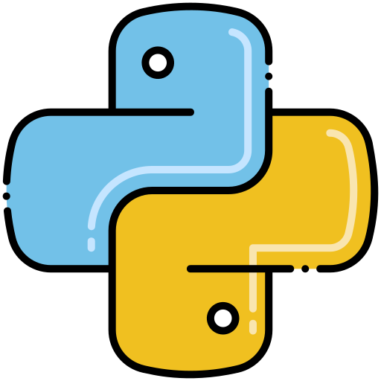
What is Programming Language?
We use language to communicate with each other
To communicate with computer: for giving instructions, we need to use a language
Python is one kind of Programming Language
C, C++, Java, C#, JavaScript etc.

Slide 6
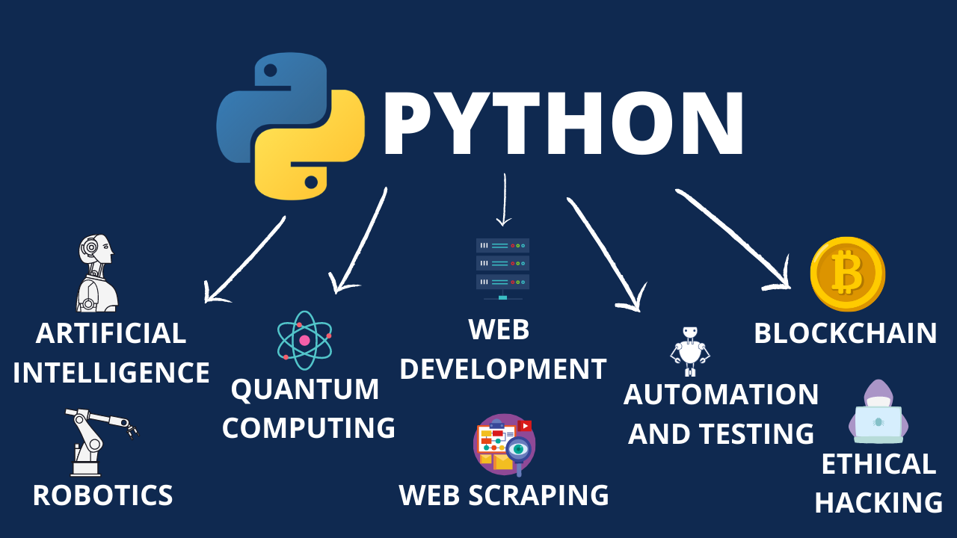
Why we choose Python?
Easy to learn and read
Versatile: Web Development, Data Analysis, Scientific Computing, Artificial Intelligence, Machine Learning, Automation

Slide 7
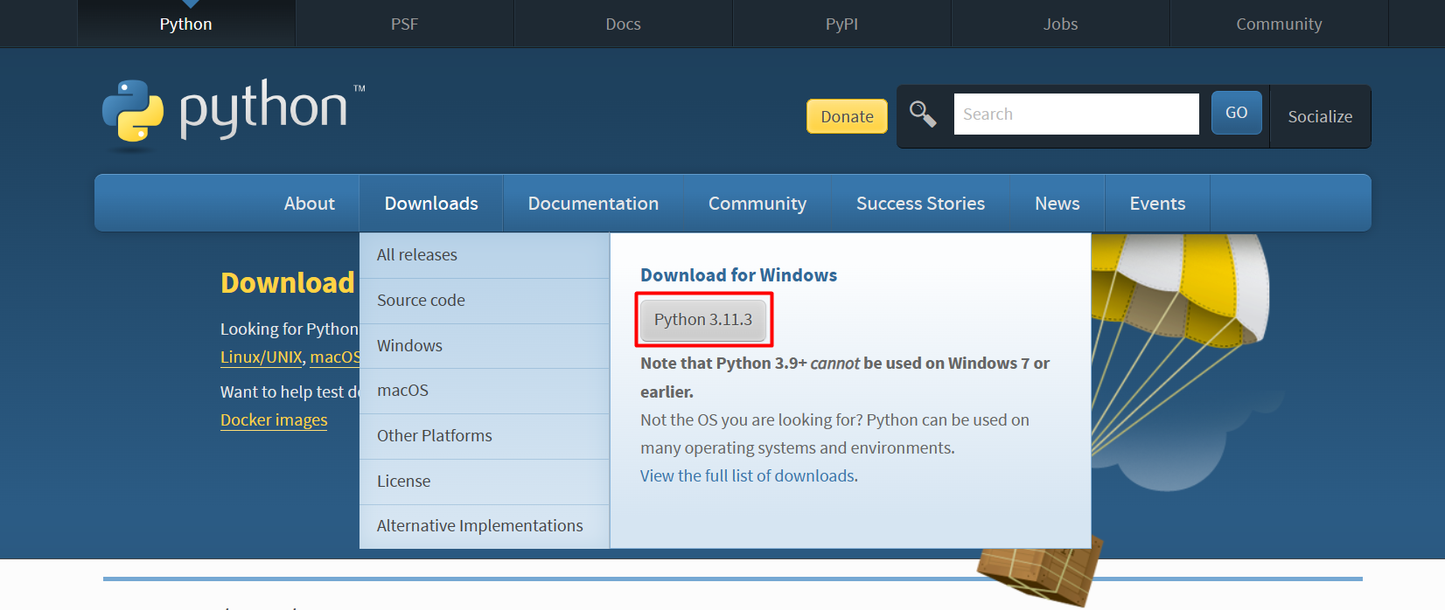
Creating Environment: Installing Python and PyCharm
To install Python: visit https://www.python.org/downloads/ -

Slide 8
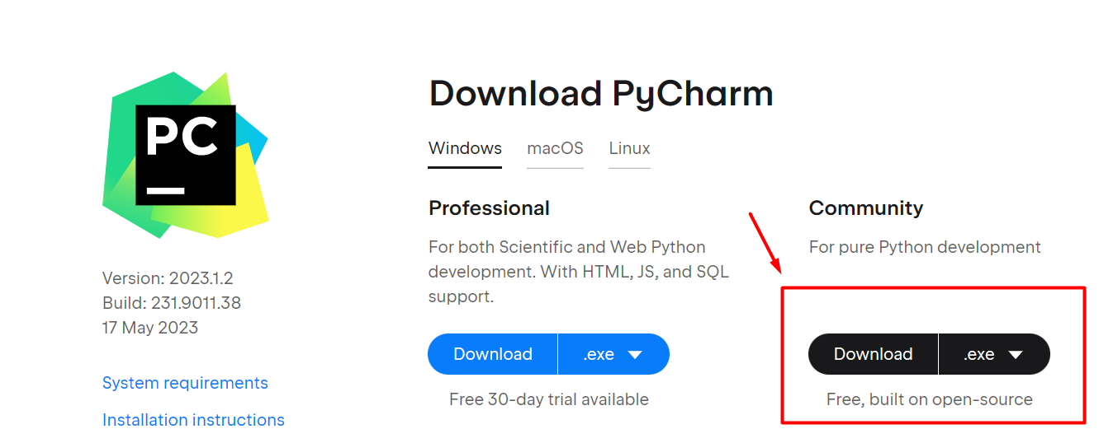
Creating Environment: Installing Python and PyCharm
To install PyCharm: visit https://www.jetbrains.com/pycharm/download/

Slide 9
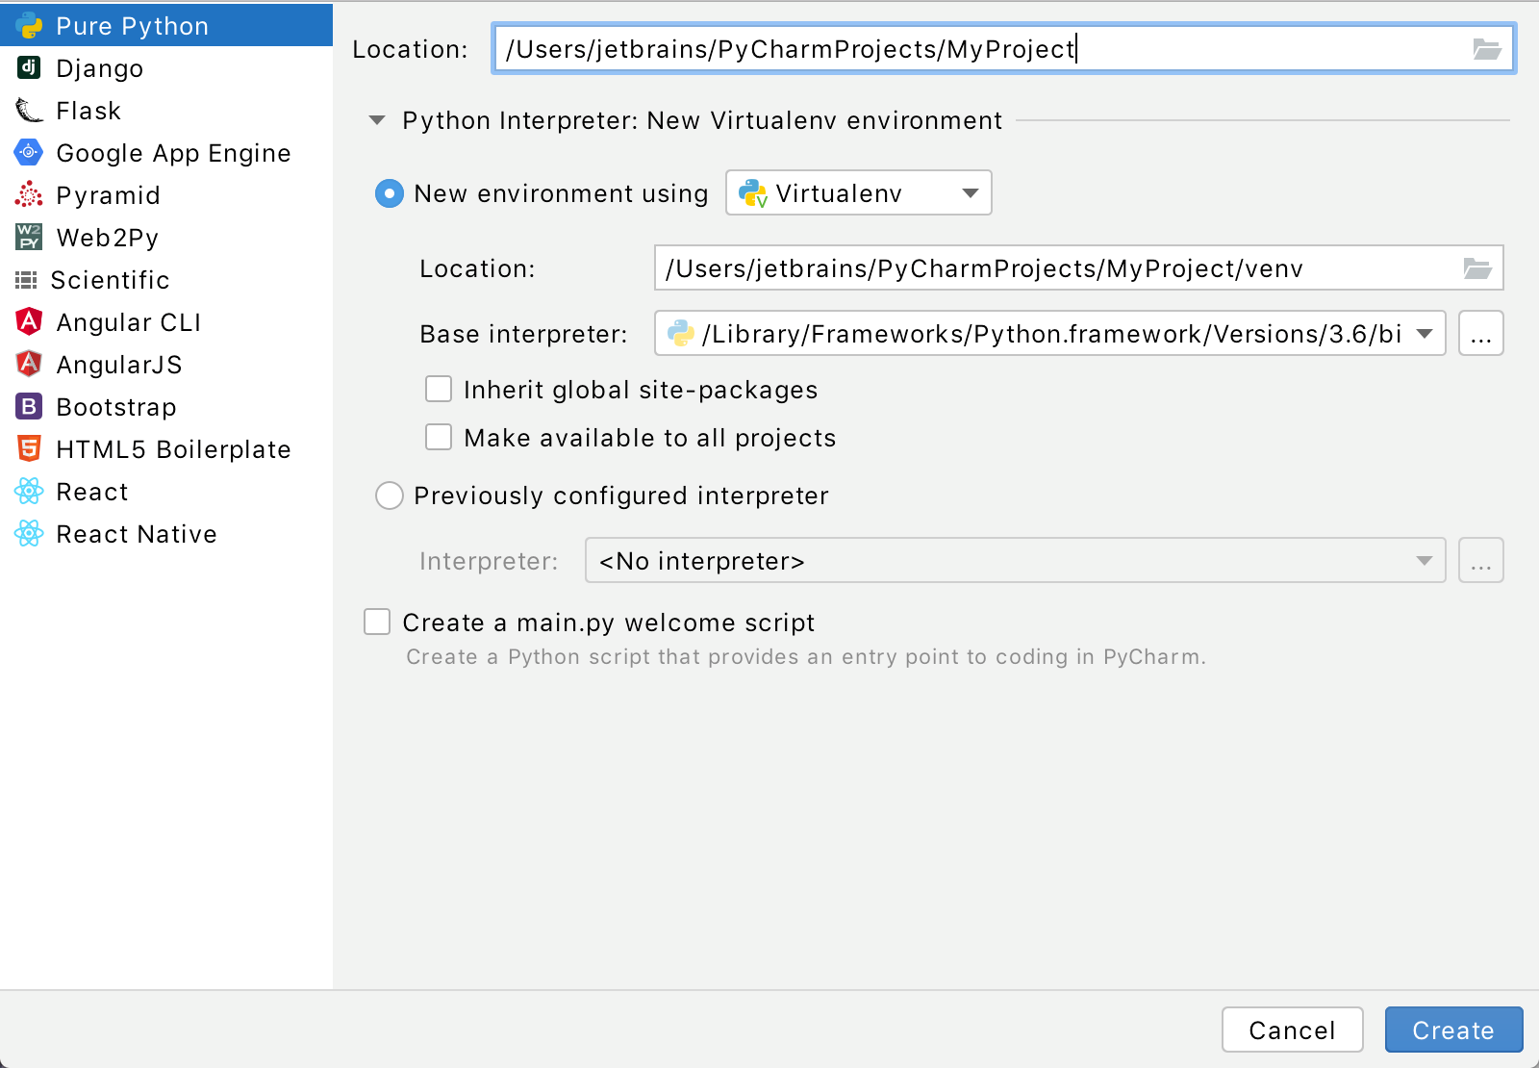
Creating Environment: Your First Python Project
If you’re on the Welcome screen, click New Project.
If you’ve already got any project open, choose File | New Project from the main menu.

Slide 10
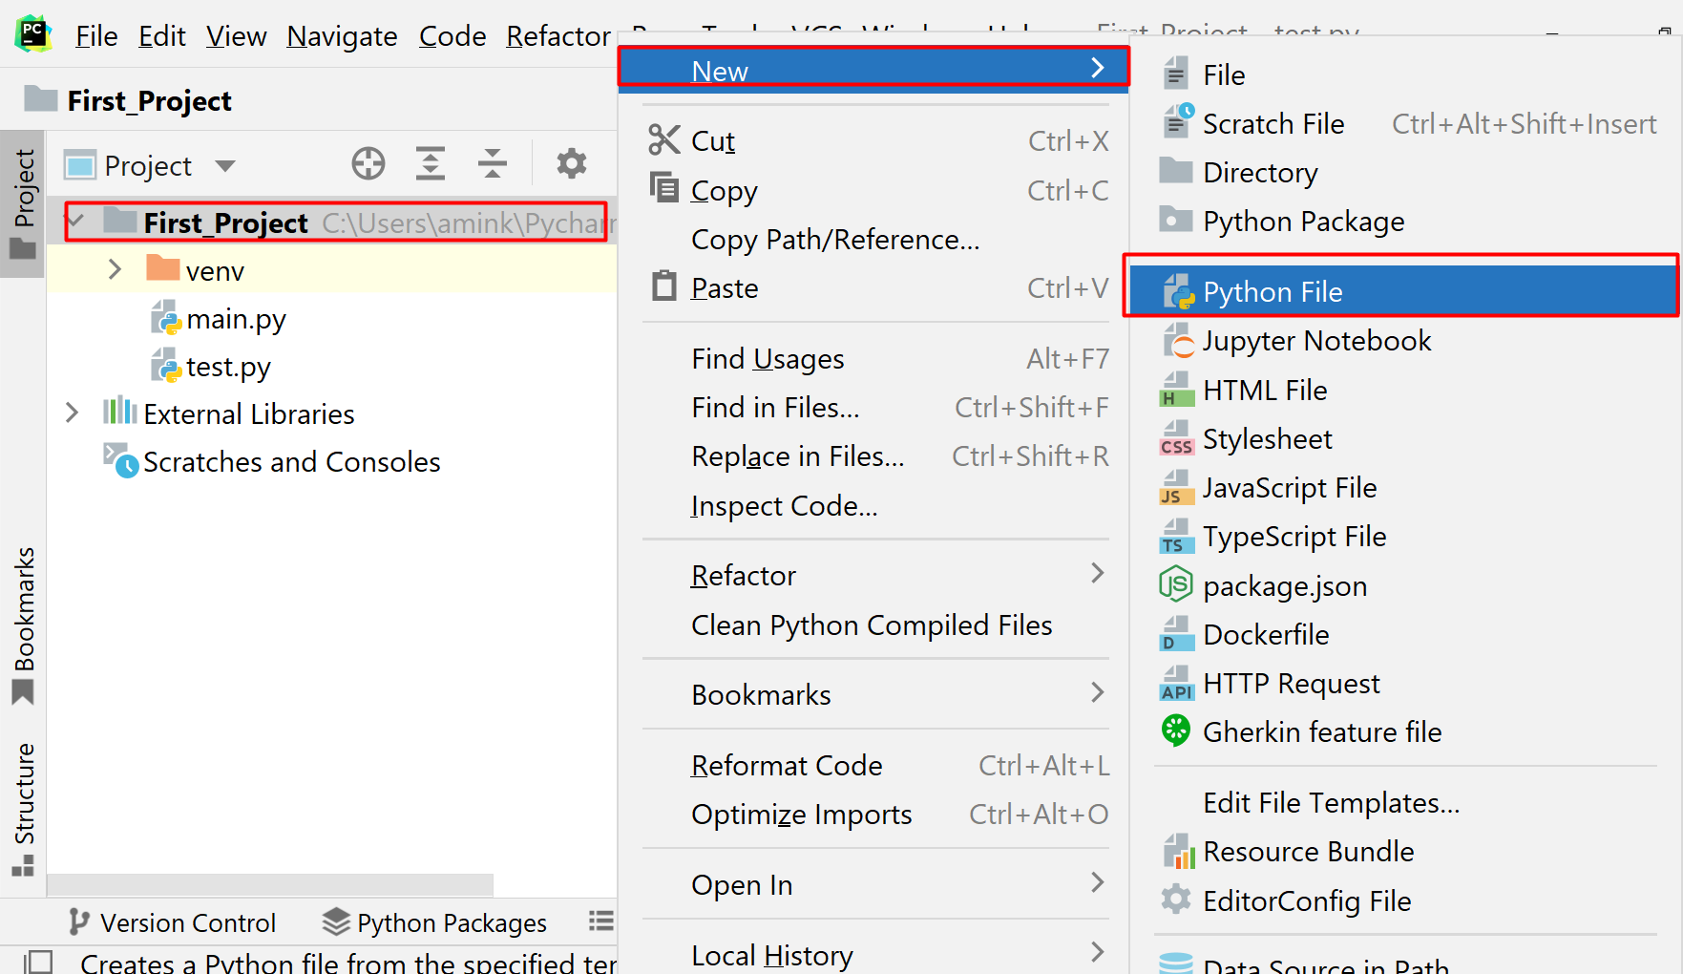
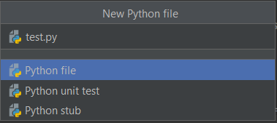
Creating Environment: Your First Python Project
In the Project tool window, select the project root (typically, it is the root node in the project tree), right-click it, and select File | New> Python File
Type a File name.py(test.py)

Slide 11
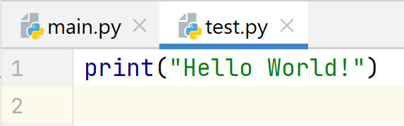
Your First Python Program: Print a Message!
print(“Your Message”)

Slide 12
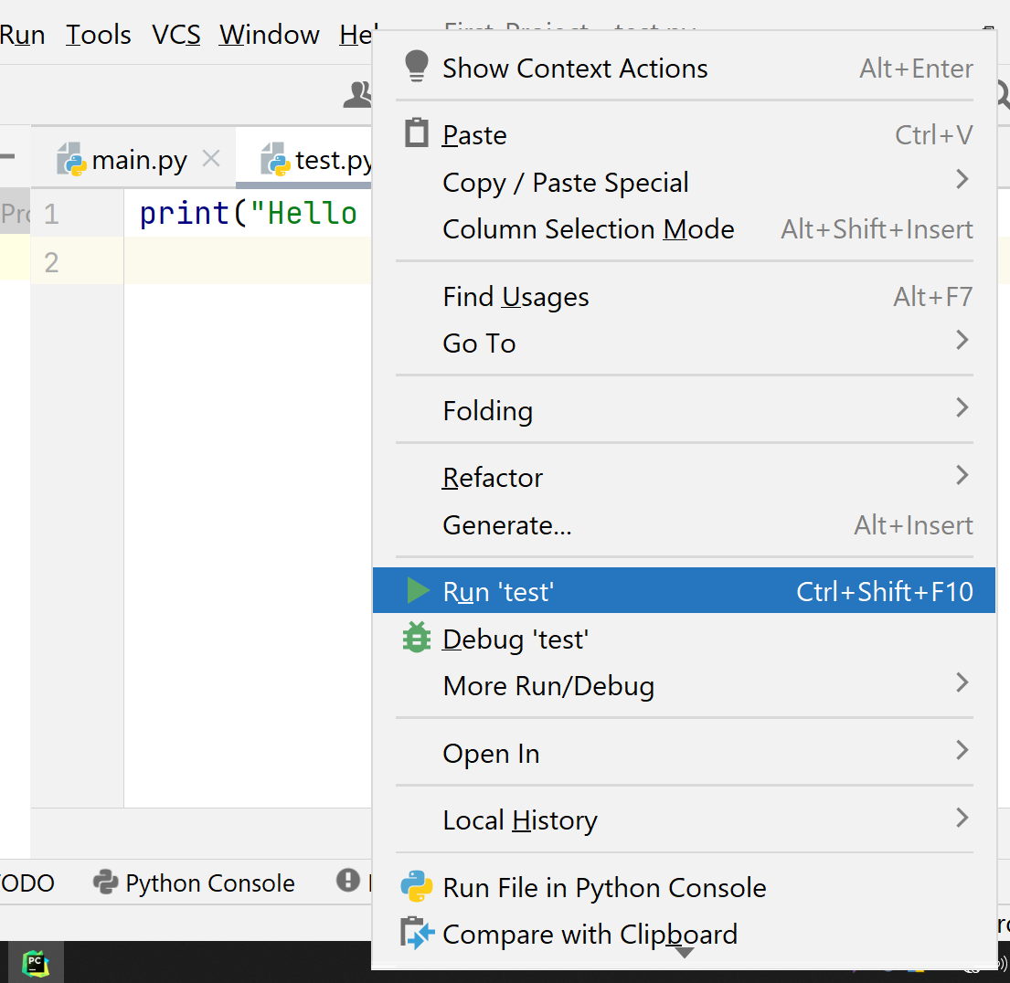
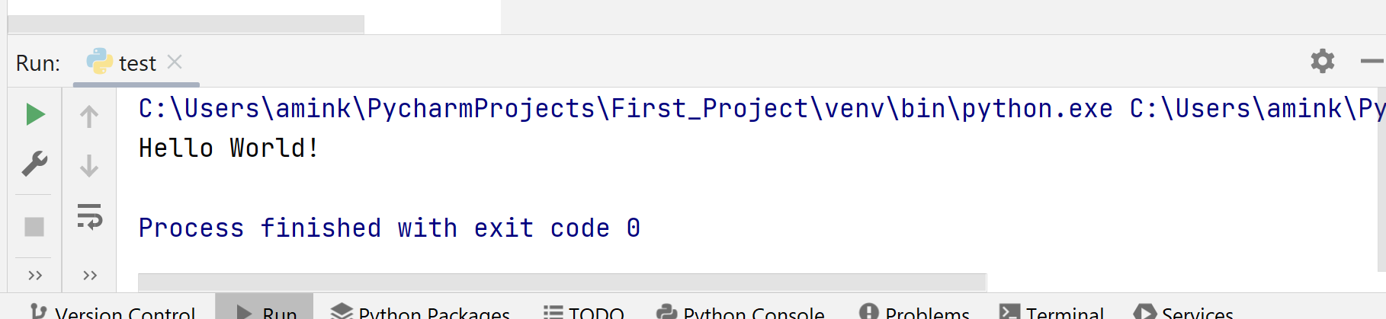
Run Your Program
Right-click the editor and select Run ‘test' from the context menu
Press Ctrl+Shift+F10
Since this Python script contains a main function, you can click an icon in the gutter.
Output:

Slide 13
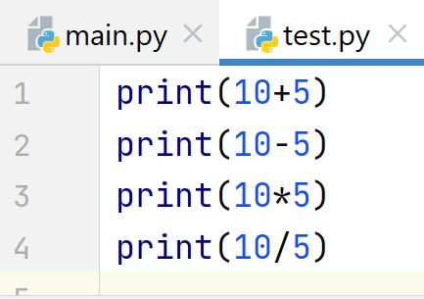
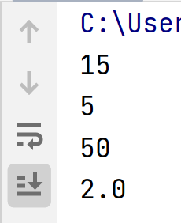
Mathematical Operations on print()
Output:

Slide 14
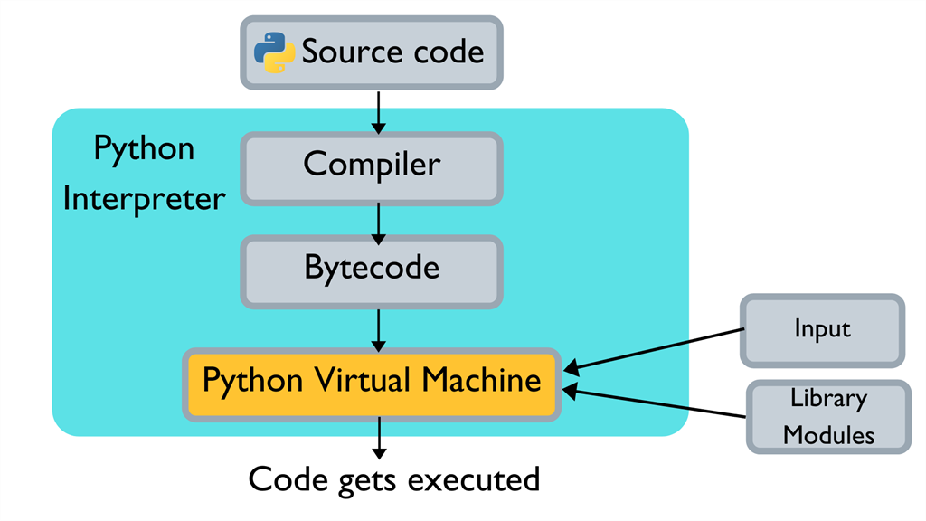
How Python Code is Executed?
We are writing our code that’s human-readable, but we know computers only understand 0/1. So how do computers understand our code?

Slide 15
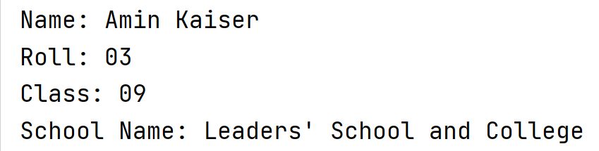
Test!
Print Your Name, Roll, Class, School Name on Output Screen

Slide 16
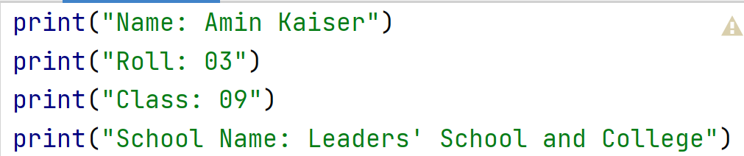
Solution!
Print Your Name, Roll, Class, School Name on Output Screen

Slide 17

Q/A Session

